Slide 1

SWIMMING POOL DATABASE MANAGEMENT SYSTEM

Slide 2
Aim: To Manage Pool Club Facilities
-Allow for booking of Swimming Pool Facilities(Slot, Locker, Accessories)
-Manage monthly club membership pass

Slide 3
Brief Description of the Project.
In this application, new users can create an account with their details such as Name, Address, Insurance number, Age and Gender.
Existing users can also login to their account.
After logging in, they will be able to book a slot at the swimming pool. They will be able to reserve accessories like head caps, fins and book a locker slot.
They can also access their account and pass details

Slide 4
FEATURES
Signup and Login Facility
User can book slots and accessories
Review and renew Monthly Pass status
Reserve your locker facility.

Slide 5
Implementation Details
Front End
>HTML
>CSS
>JavaScript
Back End
>MySQL
>PHP

Slide 6

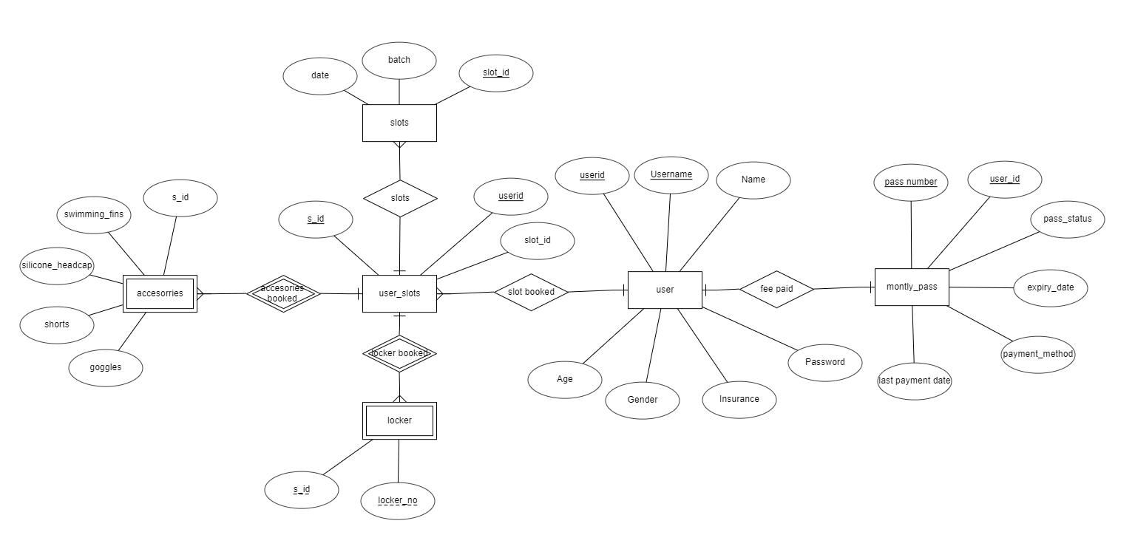
ER Diagram

Slide 7
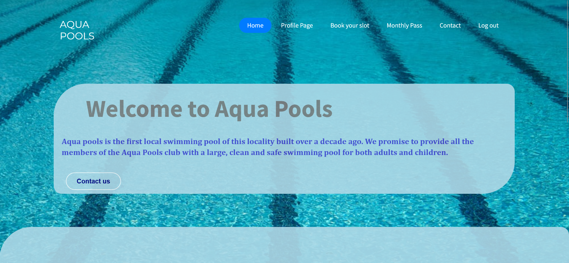
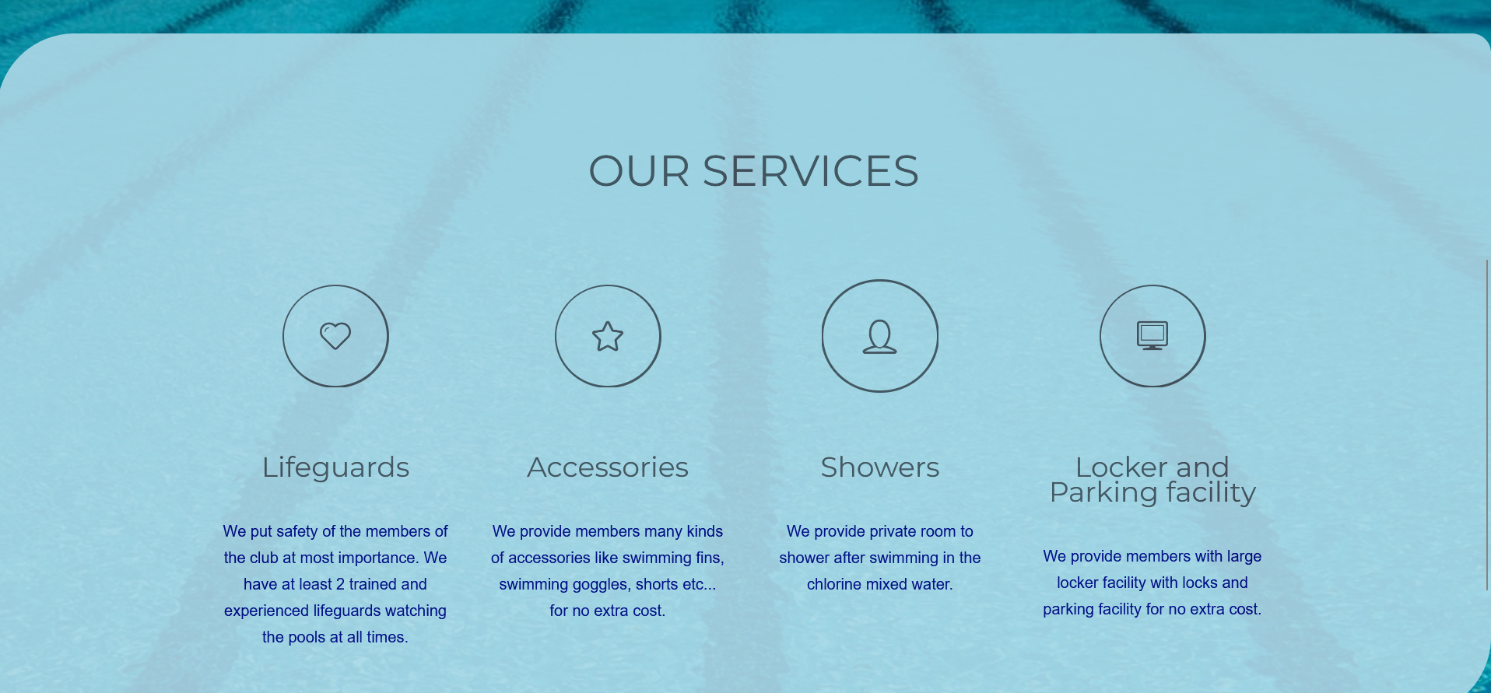
Homepage

Slide 8
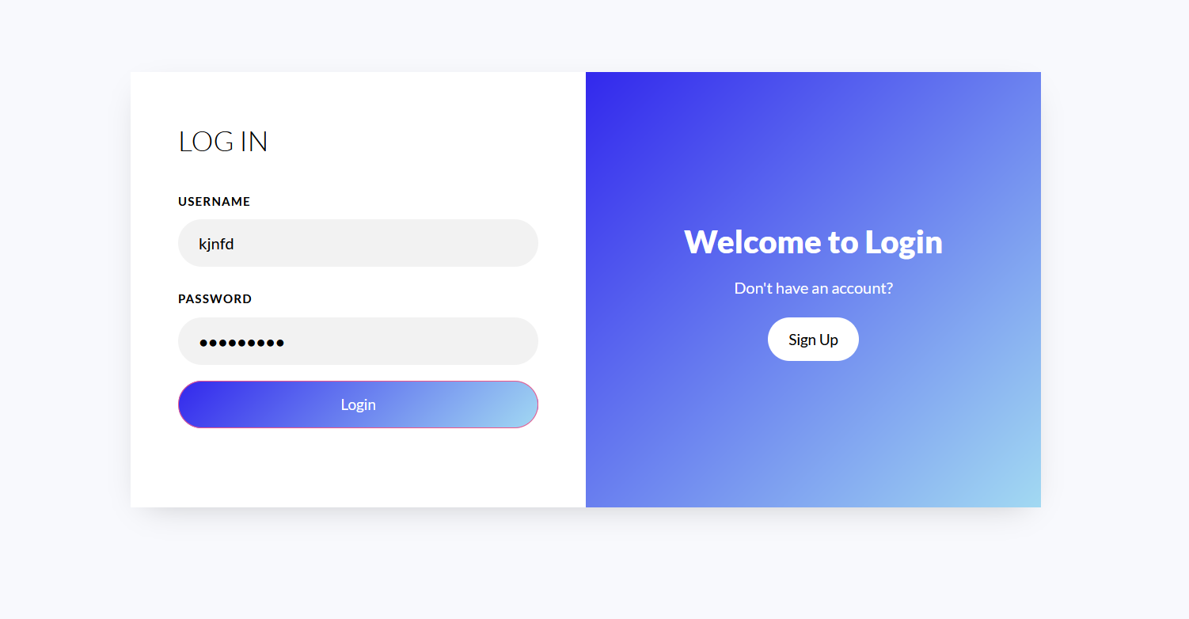
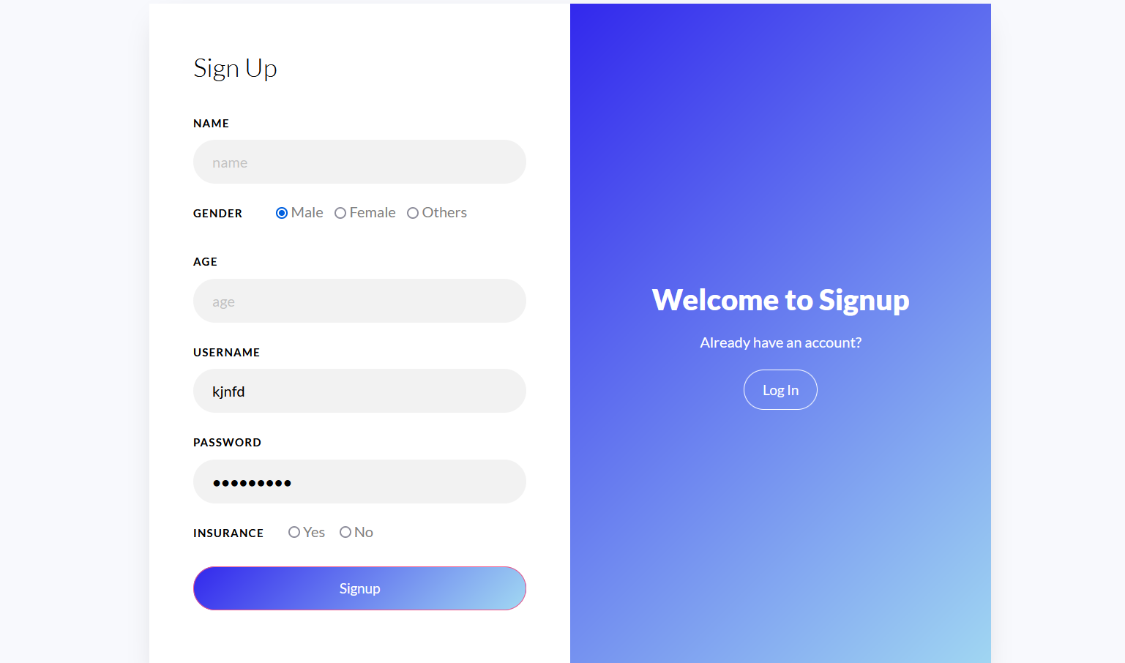
Login/Signup Page

Slide 9
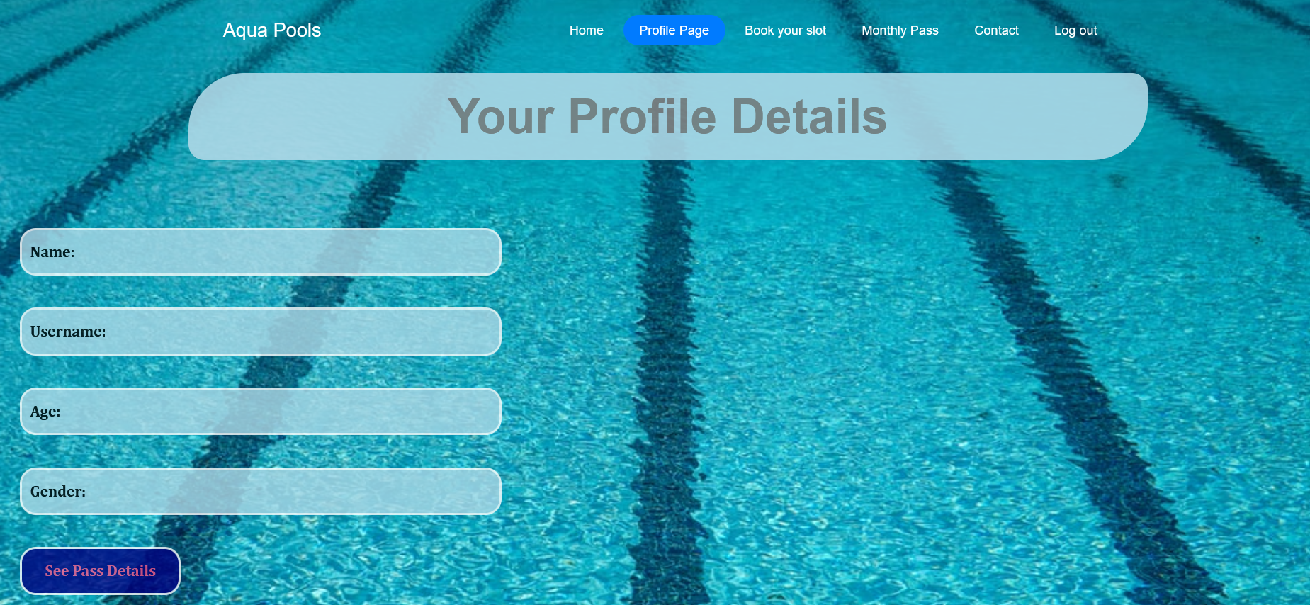
Personal Profile Page

Slide 10
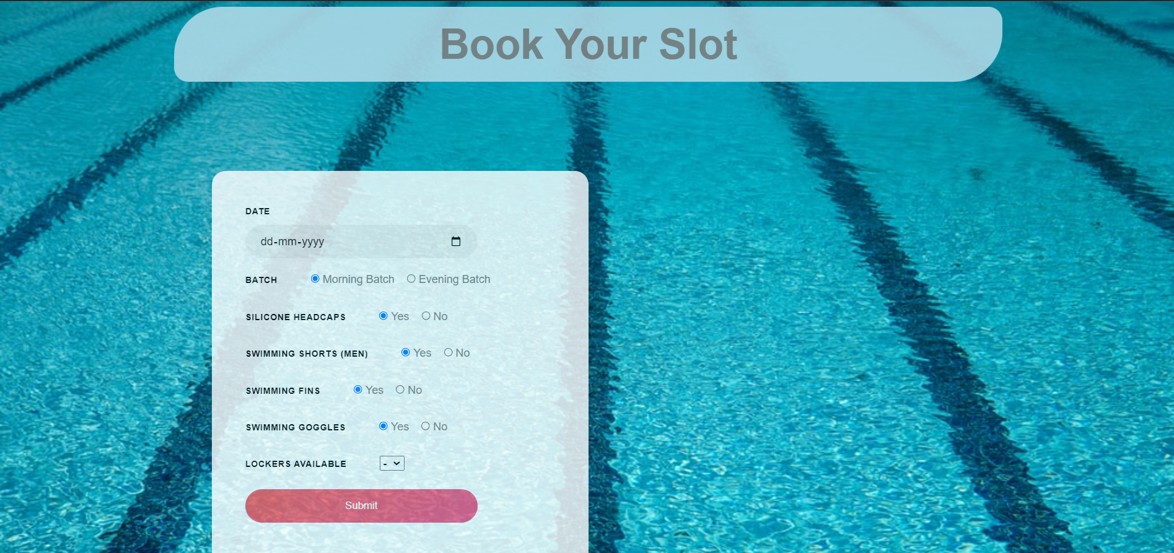
Booking page to book your slots, accessories

Slide 11
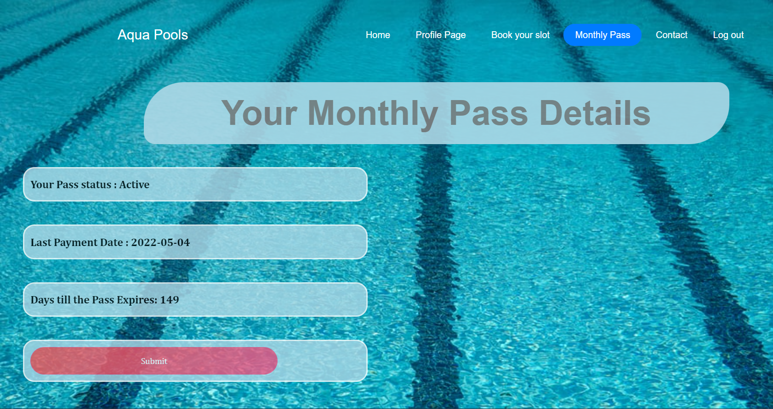
Monthly Pass details and renewal

Slide 12
Thank You!
Ayush Mandal-
201CS111
Shashank J Bennehalli-
191CS248
Balaji-
201CS114

